Slide 1
ECOMMERCE PROJECT FOR ONLINE SHOPPING
DEVELOPED BY
Title: the watch store
Name : K.V.SAAIRAAM PRASAD
REG NO: R201174600674
STUD NO: S201174600239

Slide 2

ECOMMERCE WEBSITE FOR ALL ELECTRONICS PRODUCTS
Batch Code : B200129
Start Date : 01/08/2019
End Date: 30/08/2020
Name of the Coordinator : INHUMATHI
Name of the Developer : KAARTHIK VG

Slide 3
CERTIFICATE
This is to certify that the report titled, ECOMMERCE WEBSITE FOR WATCH PRODUCTS, embodies the original work done by K.V.SAAIRAAM PRASAD in partial fulfillment of his course requirement NIIT

Slide 4
INTRODUCTION
E- COMMERCE DEFINITION
ABOUT OUR SYSTEM

Slide 5
INTRODUCTION
In todays world Online Shopping is most trending one and the famous online shopping websites are as below
Amazon SHOPFACTORY
Flip-Kart ALIBABA
E – bay ETC..
Pay pal

Slide 6
Tools & Framework
Eclipse Developer Edition
Spring MVC
Spring security
Hibernate
H2 database
Languages
HTML 5
Java Script
Boot Strap
CSS
H2 Database
Java

Slide 7
Plane Flow chart diagram of the process
user
login
select a prodcut
continue shopping or go to payment page
payment thorugh Card/ Cash
order confirmation
Payment
Receipt

Slide 8
Our System
1.) Our System is an e-commerce website from where people can buy products online
2.) Admin monitors the activity of the users and checks the transaction.

Slide 9
Features
Menu
Catalog Browsing
Category List
product List
Product Browsing
Related products
Shopping Cart
payment
checkout
Generate bill

Slide 10
Graphical User Interface

Slide 11
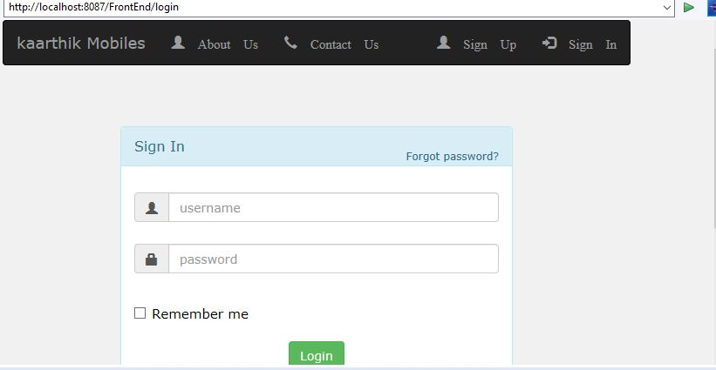
Login Page

Slide 12
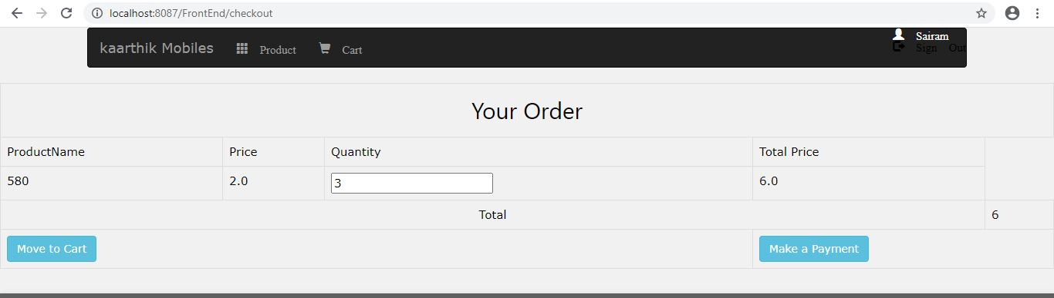
Order Confirmation page

Slide 13
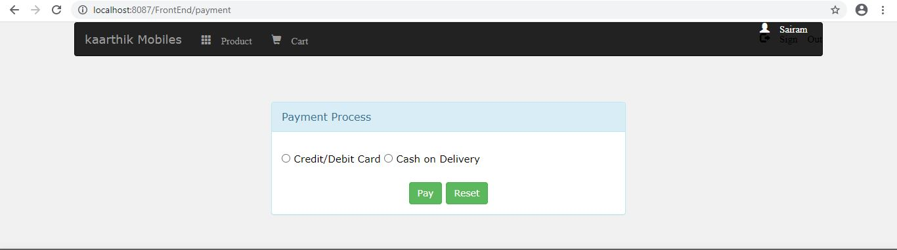
Payment process page

Slide 14
Payment process

Slide 15
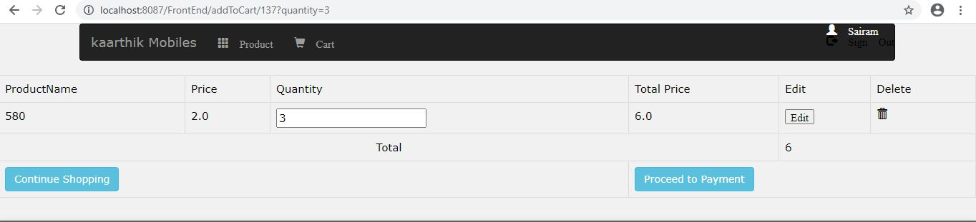
Payment Page

Slide 16
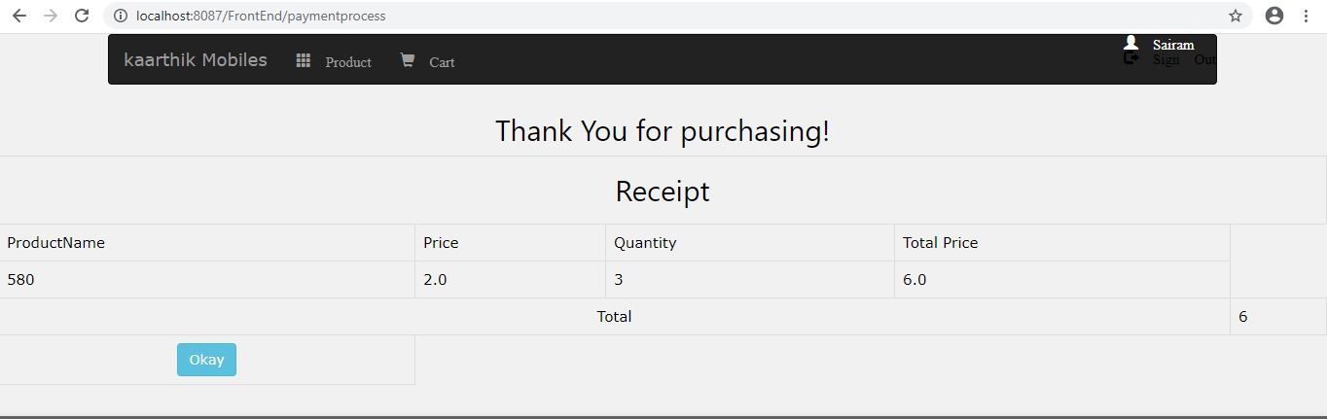
Receipt Page

Slide 17
Thank you

